Slide 1

Product Family: Music Players
Milestone 4
PRESENTED BY: MAITHILI PARIKH, PRAVEEN KUMAR MEDAPATI, KRUPA MERUPU

Slide 2
Family: Music Players
Cross platform compatible
Search and Play local music library
Create playlists and edit them
Play various formats of Music
Download Music from external websites.

Slide 3
Music Players
SONGBIRD
VLC MEDIA PLAYER
BANSHEE

Slide 4
Overview: VLC
Portable, Free and open source cross-platform multimedia player.
Packet based media player.
Framework that plays most multimedia files from any format, CD, DVD or streaming protocols.
Available in more than 75 languages.

Slide 5
Overview: SONGBIRD
First Web player, to catalyze and champion a diverse, open Media Web.
Multi-platform compatibility
Play multiple audio formats
Available in 98 languages.
Unique ability to build custom mixes and subscribe to MP3 blogs as playlists.

Slide 6
Overview: BANSHEE
Banshee is a cross-platform open-source media player.
Called Sonance until 2005.
Organize music and interact with other users via scrobbling to Last.fm.
Allows to rip music from CDs and create own audio CDs and MP3s.
Can subscribe to podcasts and download them automatically.

Slide 7
Architecture Overview

Slide 8
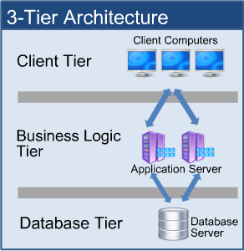
The 3-Tier Architecture
The three music players follows a 3-tier architectural pattern.
Presentation tier/Client tier: It communicates with other tiers by which it puts out the results to the client tier.
Application tier (Business Logic/Middle tier): It is pulled out from the presentation tier and, as its own layer, it controls an application’s functionality by performing detailed processing.
Database tier: It includes the data persistence mechanisms (database servers, file shares, etc.) and the data access layer that encapsulates the persistence mechanisms and exposes the data.

Slide 9
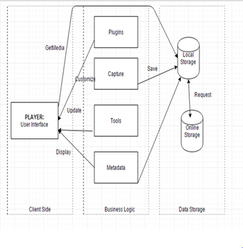
VLC Architecture
Figure. Architectural view of VLC

Slide 10
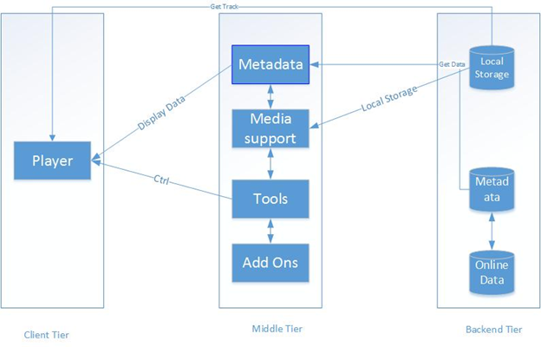
SONGBIRD Architecture
Figure : Architectural View of Clementine

Slide 11
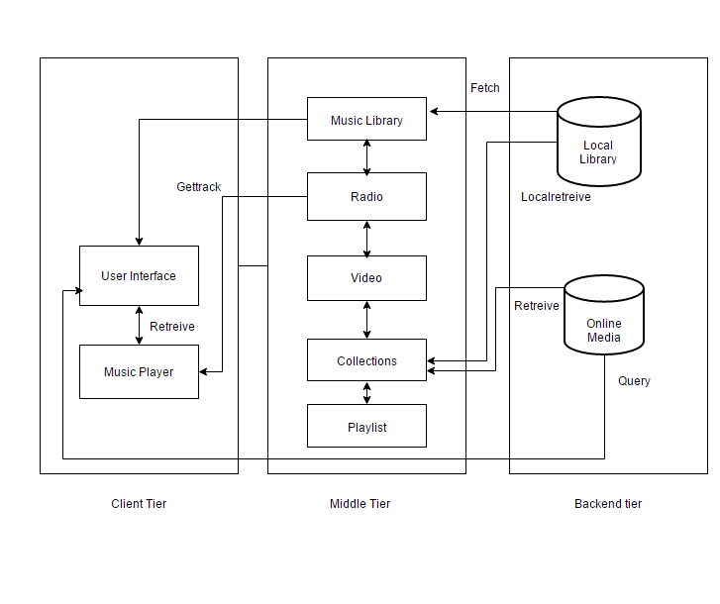
BANSHEE Architecture
Figure. Architectural view of Tomahawk

Slide 12
Feature Comparison
FEATURE : PLAY

Slide 13
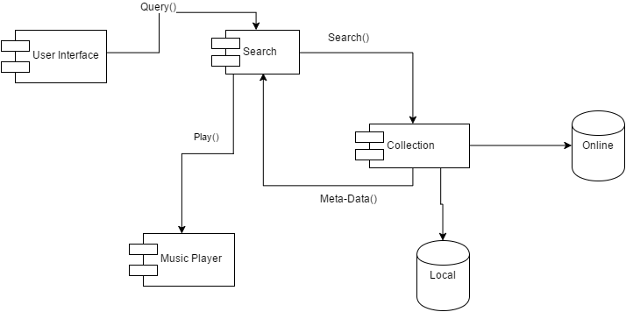
Tomahawk
Tomahawk Music Player is a metadata based player.
Data is organized using Collections
Comprise of both Local & Online Databases.
Query() retrieves appropriate file from Collections using the Search() function.
Play() sends the meta-data to the Music Player, which then retrieves the track and plays it.
Track is only retrieved when it is played.
Figure. Handling play request

Slide 14
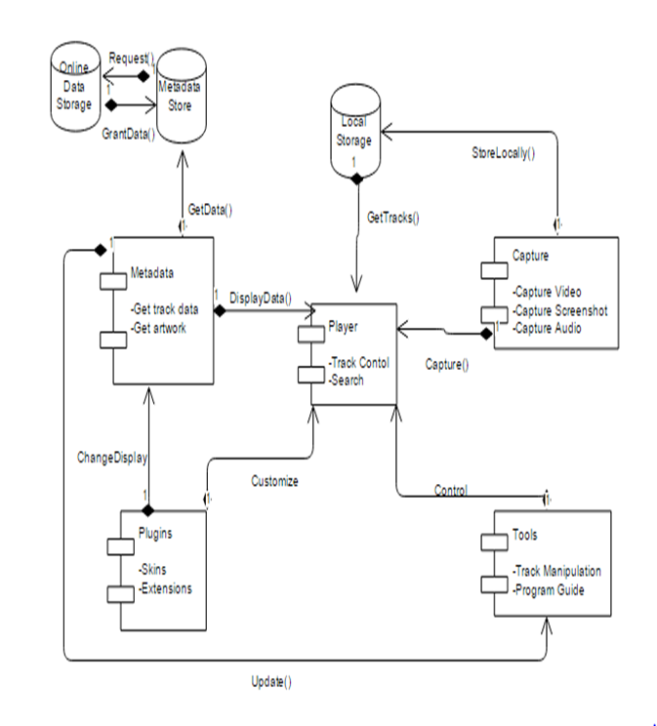
VLC
User Interacts only with the User Interface, to play a Track.
Library comprises mainly of Locally stored data, which is retrieved when a Track is chosen for playback.
A wide number of formats including MP4, WMV, AVI and DIVX are supported
Figure. Handling play request

Slide 15
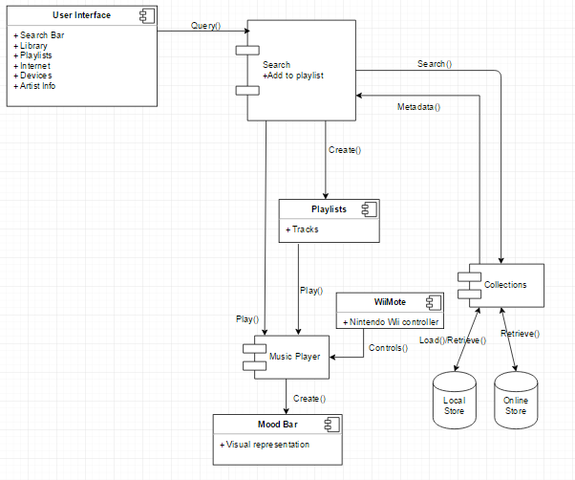
Clementine
First, a search request is made by the user for a particular song.
Then collections databases looks for the search request in the local store or online store and returns a result.
This result is then added to the playlist or it is sent directly to the player using the play() method.
A mood bar gets created to give visualization effects to the player.
Search(Result)
Keys
DB
Connectors
Figure. Handling play request

Slide 16
Comparison
Both Clementine and Tomahawk are a query based player which uses metadata to load tracks for playing.
VLC uses various modules to retrieve the desired file via local storage file retrieval.
Various visualization are available in Clementine in the form of a mod bar.
Apart from this, Clementine has Nintendo Wii compatibility which can be used to control play of a track.

Slide 17
Quality Attribute Comparison
QUALITY ATTRIBUTE : MODIFIABILITY

Slide 18
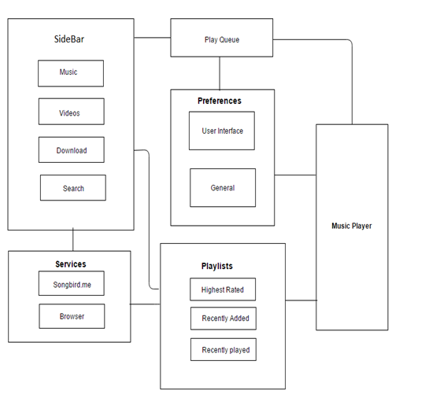
SONGBIRD
Sidebar
Doesn’t allow modifications.
Services
Allows to access music from online websites.
The UI can be modified using different themes.
User Interface can be changed along with addition of different internet providers.
This gives the player a DEGREE OF MODIFIABILITY.

Slide 19
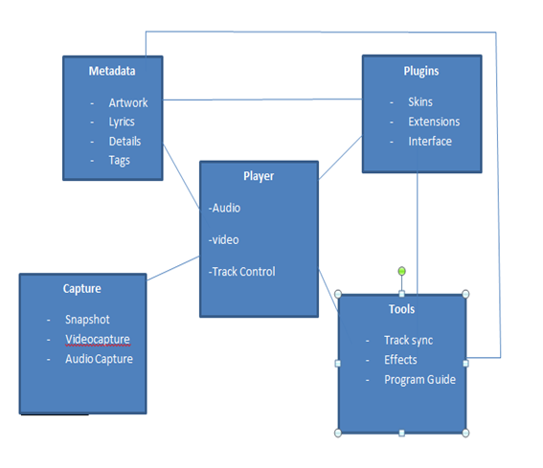
VLC
Plugins modules
Allows aspects such as UI Skins, Extensions and Plugins to be changed.
Tools
Allows modification of the software, such as default paths, “Preferences” etc
The “plugins manager” adds extra functionality like 10 band EQ, lyrics finder, compressor, sustainer bands, audio spatializer etc.

Slide 20
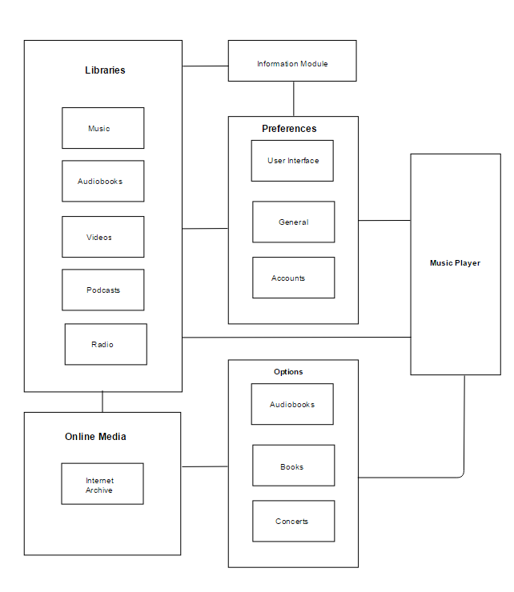
Banshee
The Online and Library modules have low coupling with an API, which performs communications regardless of the number of sub-modules involved.
Information Module
Allows inclusion of Charts from multiple sources.
Accounts sub-module can also be modified to allow more sources.
Hardware support module can be modified to allow more controllers.
Preferences can be changed based on the user.

Slide 21
Comparison
Both Songbird and VLC offer modification to the User Interface sub-module (Skins sub-module in VLC).
Banshee does not allow any change to the User Interface.
VLC allow using of plug-ins and extensions to handle many different formats not provided natively with the software.
Banshee does not allow any changes to the Player module, and as it lacks any overlaying layer to behave as a common communication interface, new formats cannot be supported.
VLC has a unique option. It allows management of Hardware Devices, add a new device and manage the device library.
Songbird has a inbuilt browser .

Slide 22
Conclusion

Slide 23
VLC media player, Songbird and Banshee and all differ in many ways.
Banshee’s simple UI with icons and symbols allows the user to use it with no confusion.
Both Songbird and VLC offer modification to the User Interface while Banshee has a very simple interface.
Music can be played by dragging and dropping the music file in Songbird or VLC, But Banshee doesn’t support this. User need to personally import the file in order to play it.
Though features like these are not a must, incorporating such friendly features enables these players to mark their uniqueness.
They also may be similar or differ based on the usability attributes which we have taken into regard: Usability and Modifiability.
All the products mentioned allow the user to have as much ease of use as possible in order to maintain their good standing in the user's point of view

Slide 24
Same functionality for all, but different UI
Difference in the way architecture fetches and posts data
Modifiability has high priority for VLC and Clementine
Usability has a high priority in both
These attributes are highly influential in the architecture design

